Slide 1
Performance Comparison of Machine Learning Algorithms on Titanic Dataset

Slide 2
Name: Sahana.C
Course : Data science
Date : 01-05-2026
Project Title :Machine Learning Algorithms on Titanic Dataset

Slide 3
Introduction
Machine Learning helps predict outcomes using data.
Titanic dataset is used for survival prediction.
Different ML algorithms are compared.

Slide 4
Objective
Apply multiple ML algorithms
Compare performance
Find best algorithm
Evaluate using Accuracy and F1 Score

Slide 5
Dataset Information
Titanic Survival Dataset
Features
Passenger Class
Age
Gender
Fare
Embarked

Slide 6
Tools & Technologies
Python
Google Colab
Pandas
NumPy
Scikit-learn
Matplotlib
Seaborn

Slide 7
Data Preprocessing
Checked missing values
Filled missing values
Converted categorical data into numerical values
Split dataset into training and testing data

Slide 8
Algorithms Used
Classification Algorithms
Logistic Regression
K-Nearest Neighbors (KNN)
Decision Tree

Slide 9
Model Training Process
Dataset
Pre-processing
Train/Test Split
Evaluation
Prediction
Model Training

Slide 10
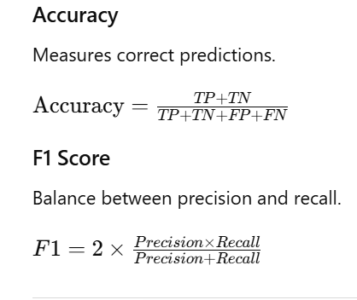
Evaluation Metrics

Slide 11
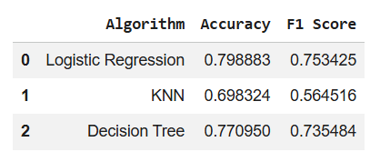
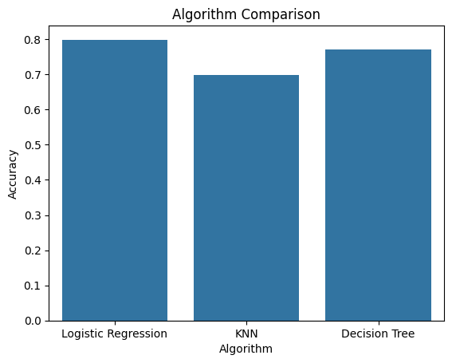
Results Table

Slide 12
Best Performing Model
Decision Tree achieved highest accuracy.
It handled dataset patterns effectively.
Therefore it performed better than other algorithms.

Slide 13
Conclusion
Multiple ML algorithms were applied successfully.
Models were compared using evaluation metrics.
Decision Tree gave best performance on Titanic dataset.

